Slide 1
Chapter 4
Database Design

Slide 2
Logical Design
Logical design is the entity design without regard to a relational database management system.
One of the principles of relational database is that the logical design should be the same regardless of the DBMS that will be used.
This means you don’t consider the particular limitations or features of a DBMS in the design.

Slide 3
Physical Design
Physical design is the logical design adapted to a particular DBMS.
The design can change slightly to fit into the limitations of a DBMS or to take advantage of DBMS-specific features.

Slide 4
Entity Relation Diagrams
Entity relation diagrams are a common way of diagramming entities, their attributes, and their relationships.
An entity is represented as a rectangle divided into three parts:
The name of the entity
The primary key
The attributes

Slide 5
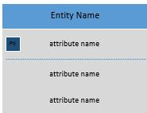
An Entity
Attributes in bold are required

Slide 6
Relationships
A relationship between entities is established by repeating one field, usually the primary key field, from one table in a second table, usually as a foreign key.
The primary key table is sometimes referred to as the “parent” table.
Tables with the foreign keys are referred to as “child” tables.

Slide 7
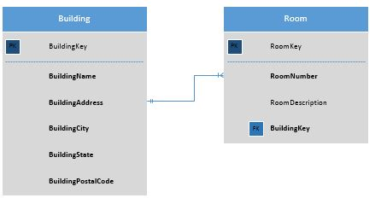
Crows’ Feet Notation for Relationships
The three lines, the crows foot, shows the “many” side of the relationship. The 0 on the building side says a building can have zero or many rooms, the line on the room side says a room must have a building.

Slide 8
Naming Conventions
Naming conventions are crucial for good design.
Ideally you should have a consistent way of naming database objects, such as tables, attributes, keys, and any other database objects, such as stored procedures and triggers.

Slide 9
Book Naming Conventions
Entities and tables are named as single nouns like Tutor, Student, and Session.
Attributes are named with the entity name followed by the attribute name. There are no underscores between. Each new word is capitalized: TutorLastName,
StudentLastName, and so on. This can make for long attribute names, but it makes for maximum clarity.
Primary keys end with the word “Key”: TutorKey, StudentKey, and so on.
Foreign keys retain the name of the primary key.

Slide 10
Term Equivalencies
Logical Design | Physical design | Theoretical
Entity | Table | Relation
Attribute | Column, field | Attribute
 | Row, record | Tuple

Slide 11
Repeating Fields
When creating an entity that can contain many of the same attributes, it is tempting to list or number them.
For example, a tutor can tutor many classes.
The temptation is to create an entity like the following (see next slide):

Slide 12
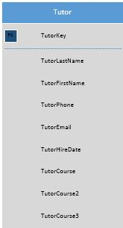
Repeating Attribute Entity

Slide 13
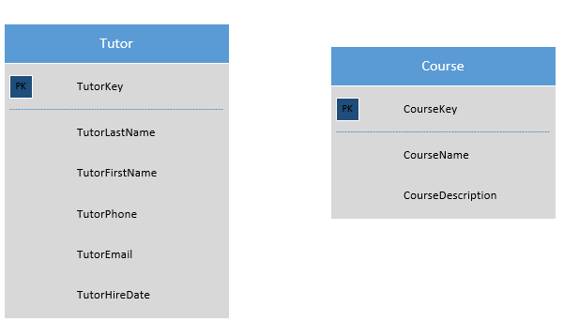
Resolution
Numbering attributes is always a mistake.
It is a sign that you should split the entity into two separate entities

Slide 14
Relationships
There are three types of relationships between entities:
One to one
One to many
Many to many

Slide 15


One to One
A one-to-one relationship means that for every one record in the primary key table, there is no more than one related record in the foreign key table.
Below are the crow’s feet notation for this relationship:
Zero or one
Exactly one

Slide 16
Notes on One-to-One Relationships
One-to-one relationships are rare.
They can be used to rid an entity of null (empty) attributes that inevitably result when contents of an entity have different attributes.
They are sometimes used when data is split between entities for security reasons.

Slide 17
One-to-One Relationship to Prevent Nulls

Slide 18
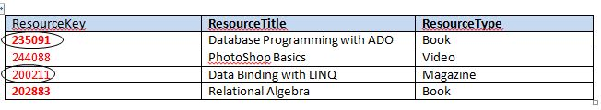


Table Example: One to One For Reducing Nulls

Slide 19
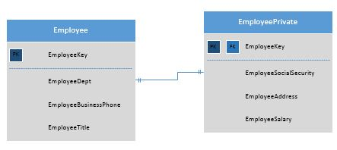
One to One for Security Reasons

Slide 20


One to Many
One to many is the normal relationship between tables.
It means that for every one record in the parent entity, there can be zero to infinity records in the child entity.
Here are the crow’s feet symbols for one to many relationships:
One to zero or many
At least one or many

Slide 21
One to Many Diagram
One Department can contain many Employees

Slide 22
Table Example of One to Many
DepartmentKey | DepartmentName | DepartmentPhone | DepartmentRoom
ACC | Accounting | (206)555-1234 | SB201
IT | Information Technology | (206)555-2468 | NB100
EmployeeKey | EmployeeLastName | EmployeeFirstName | DepartmentKey
FB2001D | Collins | Richard | IT
BN2004N | Faulkner | Leonore | IT
NC2004M | Brown | Carol | ACC
LL2006O | Anderson | Thomas | IT

Slide 23
Caution: Cross Relationship Error
There is a temptation to think that because a department contains many employees, that the relationship should go both ways. Doing this, however, makes it impossible to enter data since before you enter a department, there must be an existing employee in the Employee table, and before you enter an employee, there must be an existing department in the Department table. The result is an unusable stalemate.

Slide 24

Many to Many
A many-to-many relationship means that each record in the primary entity can have many related records in a second entity and each record in the second entity can have many related records in the primary entity.
Many-to-many relationships are legal in logical design, but no DBMS can implement them.

Slide 25
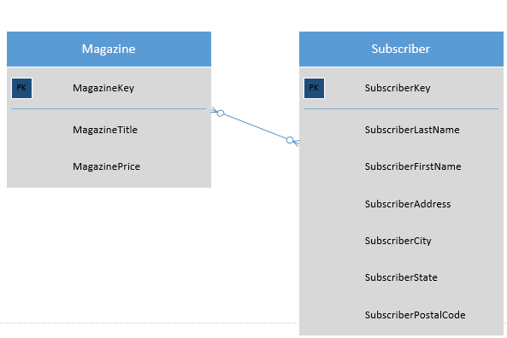
Example of a Many-to-Many Entity Relationship

Slide 26
Resolving Many-to-Many Relationships
Many-to-many relationships must be resolved into two one-to-many relationships.
To do this, it is necessary to create a linking between the two tables that have many-to-many relationships.

Slide 27
Many-to-Many Relationship Resolved

Slide 28
Table View: Magazine and Subscriber
MagazineKey | MagazineName | MagazinePrice
TM2K1 | Time | 35.50
NW2K1 | Newsweek | 36.40
SubscriberKey | Subscriber LastName | Subscriber FirstName | Subscriber Address | Subscriber City | Subscriber State | Subscriber PostalCode
4231 | Johnson | Leslie | 101 Best Ave. | Seattle | WA | 98007
4333 | Anderson | Mark | 1200 Western Blvd. | Tacoma | WA | 98011
5344 | Manning | Tabitha | 100 Westlake | Seattle | WA | 98008

Slide 29
Linking Table: Subscription
SubscriptionKey | MagazineKey | SubscriberKey | SubscriptionStartDate
1004 | TM2K1 | 4333 | 1/15/2009
1005 | NW2K1 | 4333 | 1/15/2009
1006 | NW2K1 | 4231 | 2/1/2009
1007 | TM2K1 | 5344 | 2/15/2009

Slide 30
Cardinality
Cardinality describes the number of permissible relationships between two entities.
Maximum cardinality refers to the maximum number of permitted relationships. (For example, a customer can have no more than 4 listed emails.)
Minimum cardinality refers the minimum number of permitted relationships. (For example, each customer must have at least one purchase in the purchase table.)

Slide 31
Types or Roles of Entities
Entities can take on different roles.
Below is a table of some common roles or types:
Entity Roles | Description
Domain | Entity describing a core business element of the database
Linking | Entity used to resolve a many-to-many relationship into two one-to-many relationships
Lookup | Entity used to store lookup values and help ensure data integrity and consistency
Weak | An entity that depends on another entity for its meaning

Slide 32
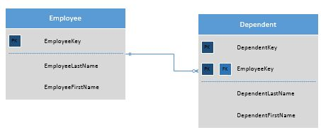
Example of a Weak Entity
An employee can have many dependents, so it is a good design practice to create a separate entity to describe dependents. However, the Dependent entity is a weak entity because it depends on Employee for its meaning.

Slide 33
Documentation
Diagrams often communicate more clearly than words.
It is important to keep all your entity diagrams for documentations along with notations about changes and versions.

Slide 34

All rights reserved. No part of this publication may be reproduced, stored in a retrieval system, or transmitted, in any form or by any means, electronic, mechanical, photocopying, recording, or otherwise, without the prior written permission of the publisher. Printed in the United States of America.

